Slide 1
Discord Quiz Bot
An Interactive Quiz Bot with Various Questionnaires and Score Tracking
Presented By: Trapti Patidar

Slide 2
CONTENTS
Introduction
Features
General Knowledge Questions
Technology Questions
Mathematics Questions
Rock-Paper-Scissors Game
Database and Score Tracking
Implementation Details
Future work

Slide 3
Introduction
The Discord Quiz Bot is designed to engage users with various types of quizzes and interactive games.
It leverages Discord.js for bot interaction, Express for the backend API, and a database for score tracking.

Slide 4
Features
Questionnaires
General Knowledge
Technology Questions
Mathematics
Rock-Paper-Scissors Game
Score Tracking
Maintains user scores and high scores.
Displays leaderboards.

Slide 5
Technologym Used
JavaScript
Discord.js
Mongo db
Express js

Slide 6

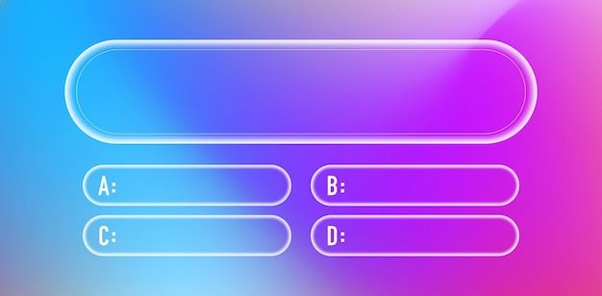
General Knowledge Questions
Uses a predefined set of questions.
Randomly selects and presents a question to the user.
Who is the current president of the USA?
Joe Biden
Donald Trump
Barack Obama
George Bush

Slide 7
Technology Questions
Questions related to programming languages and AI/ML.
Backend API provides a large pool of questions.
What is the time complexity of binary search?
O(n)
O(n^2)
O(n^3)
O(log n)

Slide 8
Mathematics Questions
Generates random arithmetic, algebra, and geometry questions.
What is the sum of 15 and 28?
33
43
53
63

Slide 9
Rock-Paper-Scissors Game
Simple, interactive game.
Users type their choice and the bot responds with its choice and the result.
Example: User types "!rps rock" and the bot responds "Bot chose scissors. You win!"

Slide 10
Backend API
Developed using Express.js.
Provides endpoints for fetching technical questions.
Sample endpoint: GET /quiz
Response format: JSON with question, options, and correct answer.Response format: JSON with question, options, and correct answer.

Slide 11
Implementation Details
Architecture
Bot handles user interaction.
API serves technical questions.
Database manages scores.
Flow
User requests a quiz.
Bot fetches a question (local or API).
User answers, and the bot checks correctness.
Score is updated in the database

Slide 12
Challenges and Solutions
Challenges
Managing API rate limits.
Ensuring question randomness.
Maintaining database performance.
Solutions
Implement caching for frequent API calls.
Use randomization algorithms.
Optimize database queries and indexing

Slide 13
Future Enhancements
Improvements
Add more question categories.
Introduce time-based quizzes.
Enhance user interface with rich embeds.
Implement multi-player quiz games.

Slide 14
Thankyou
Presented By: Trapti Patidar

